Slide 1
EN 204
Material Science for Energy Applications
Class 9
Shaibal K Sarkar
Department of Energy Science and Engineering
shaibal.sarkar@iitb.ac.in

Slide 2
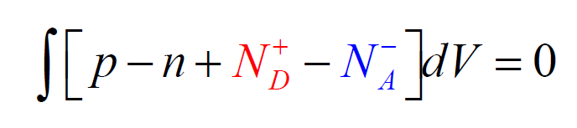
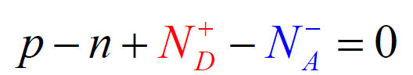
Donor and Acceptor statistics
What is the difference between N_{D} and N_{D}⁺ ?

Slide 3
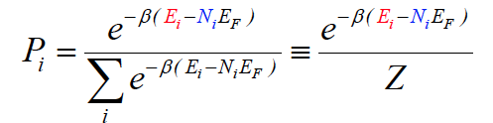
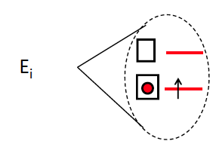
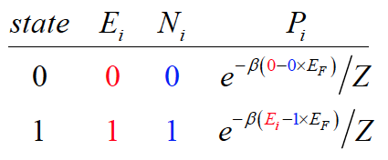
Look back to Fermi Dirac Statistics
Partition Function Approach

Slide 4
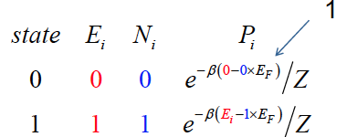
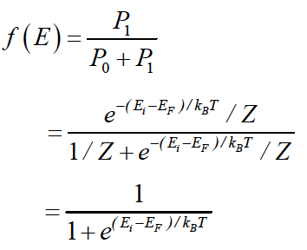
Look back to Fermi Dirac Statistics

Slide 5
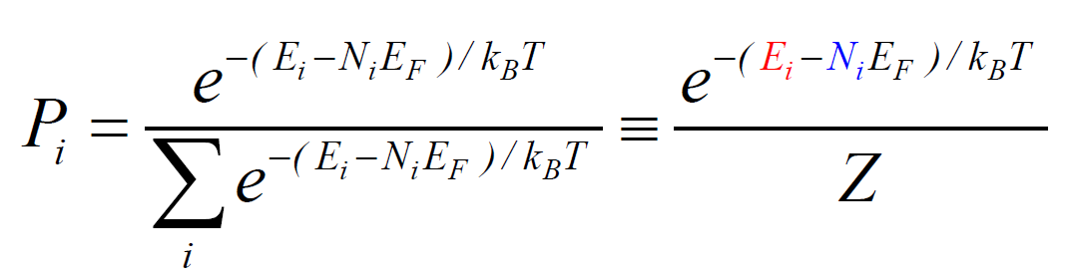
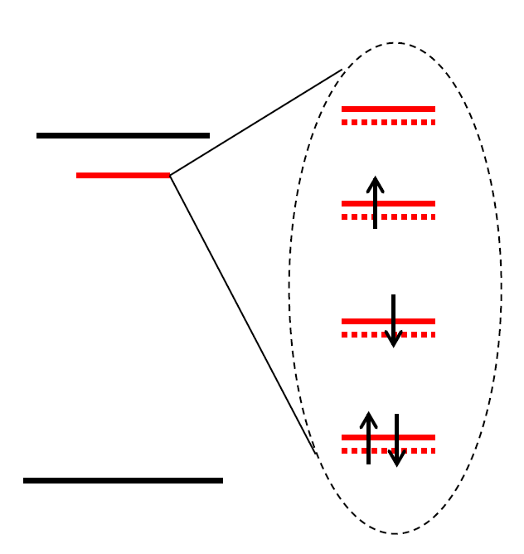
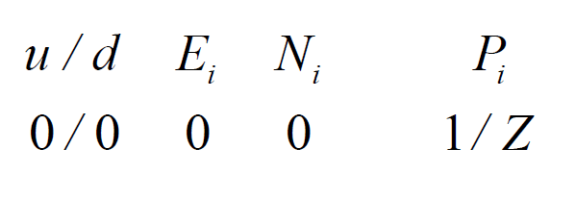
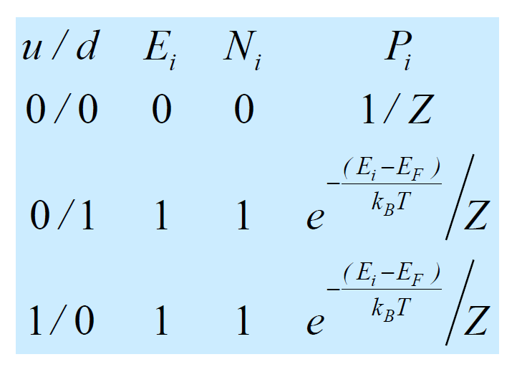
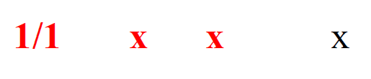
Statistics of Donor Levels

Slide 6
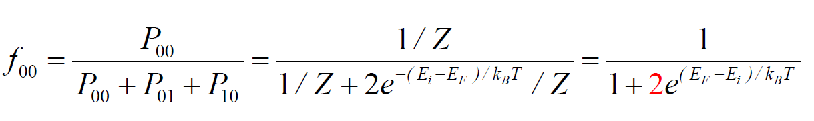
Statistics of Donor Levels
Probability that the Donor level is empty, i.e. the Donor gave away the charge

Slide 7
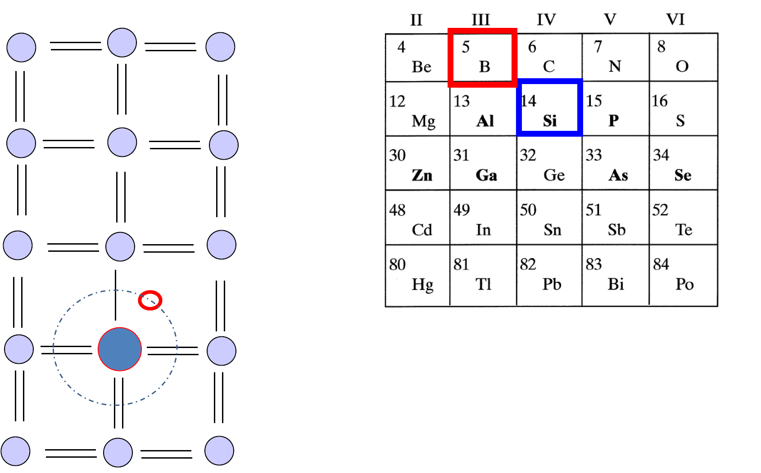
Acceptor Atoms

Slide 8
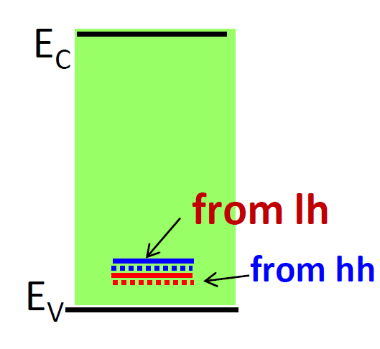
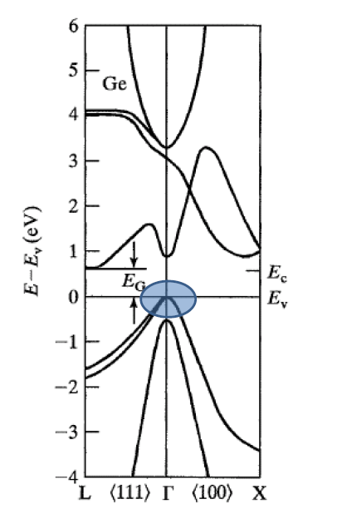
Statistics of Acceptor Levels in Si and Ge
1. Each atom contributes 2 states (up & down spin) to a band, therefore a band has 2N states.
2. Every time a host atom is replaced by a impurity atom, 2 states are disappear per a band and appear as localized states.
3. Therefore an acceptor atom close to hh and lh bands removes four states from those bands.
4. Because of Coulomb interaction only 1 hole can seat in these 4 states: the states are
0000, 0001, 0010, 0100, 1000.
5. One now uses P_{i} to compute the occupation of acceptors.

Slide 9
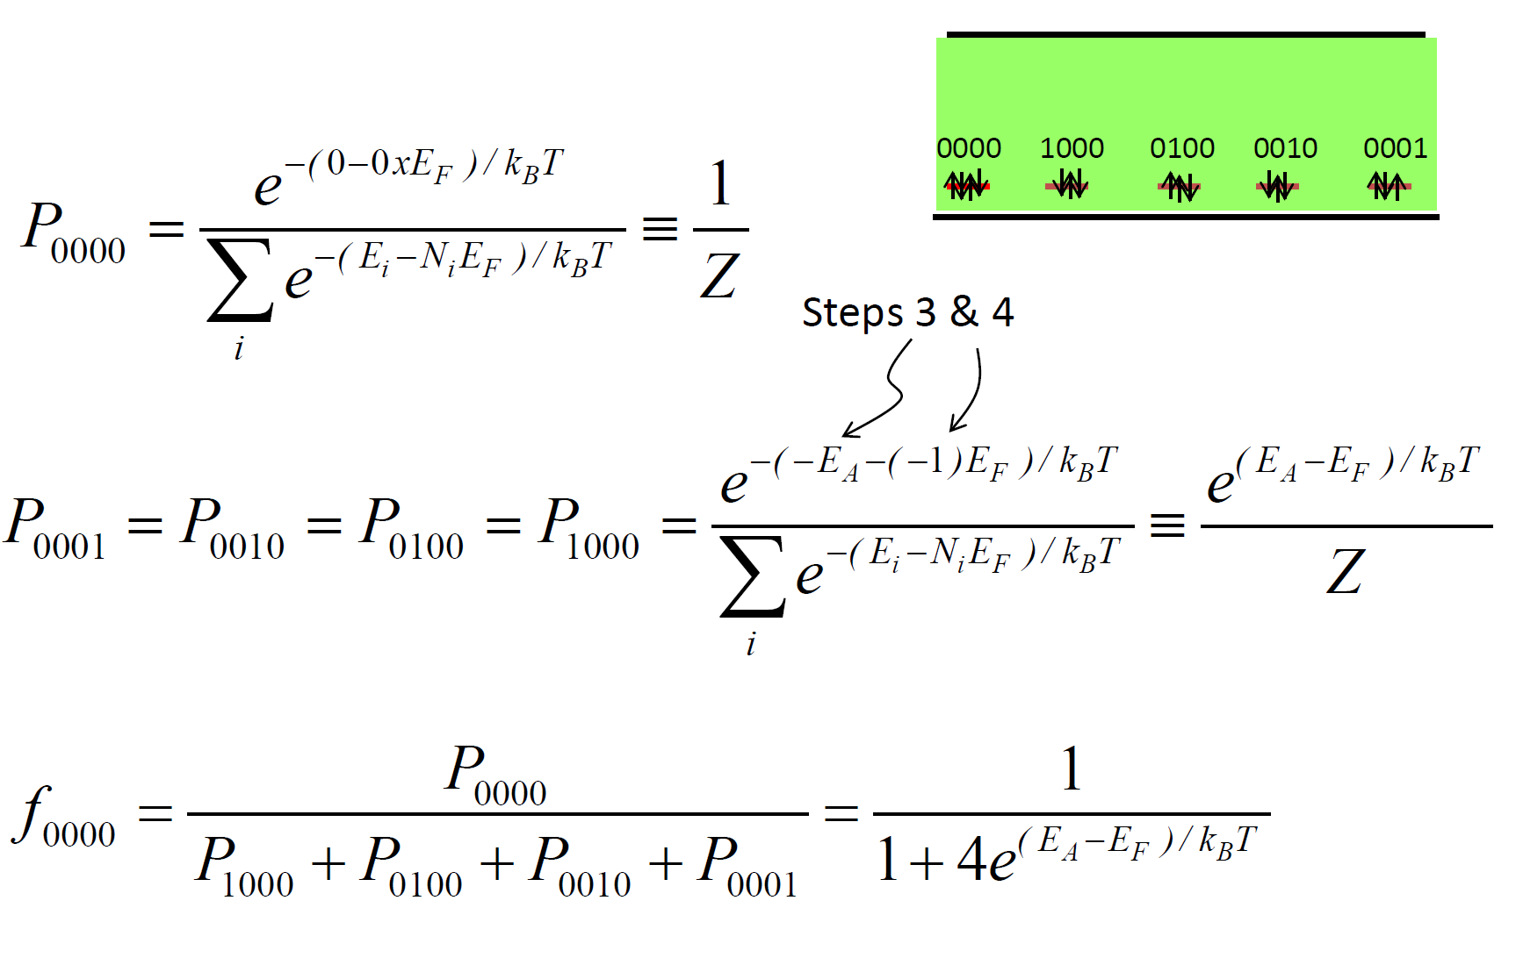
Statistics of Acceptor Levels

Slide 10
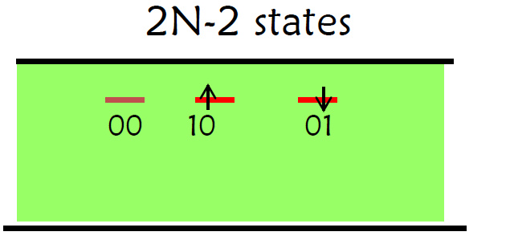
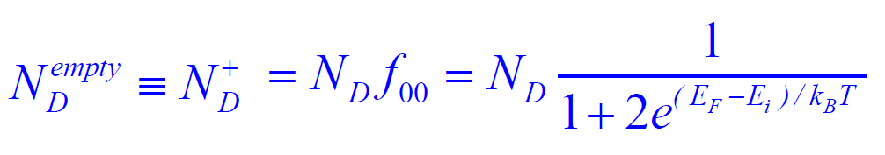
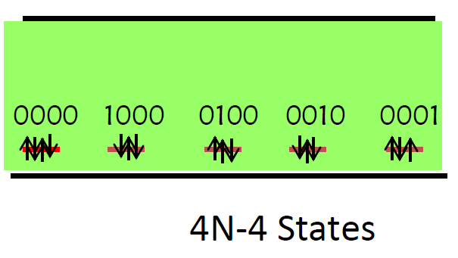
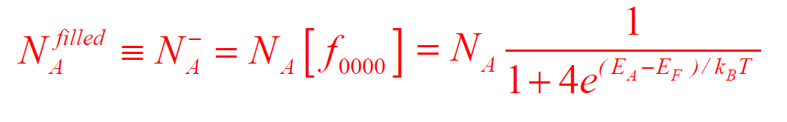
Filled and Empty Donor/Acceptor Levels

Slide 11
What we finally get?
Donor and Acceptor Statistics

Slide 12
Lets continue from there..
Charge neutrality condition

Slide 13
A few derivations………
Intrinsic Semiconductor
Charge Balance Equation
Intrinsic Fermi Level

Slide 14
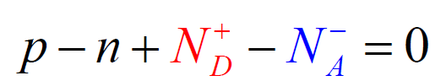
Equilibrium Carrier Concentrations

Slide 15
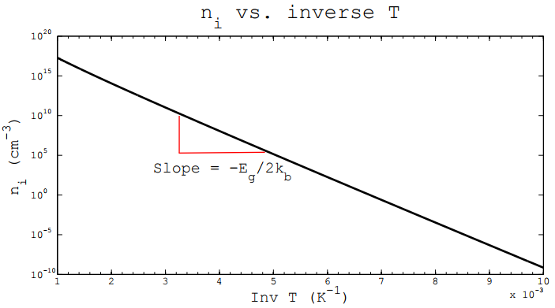
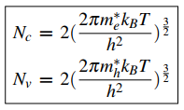
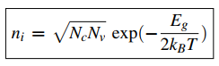
Intrinsic Carrier Concentrations vs. Temperature
n_{i} is very sensitive to temperature
in Silicon,
Increasing T = 300 → 330 K
Results n_{i} = 10¹⁰ → 10¹¹ cm⁻³

Slide 16
Intrinsic Carrier Concentrations vs. Temperature

Slide 17
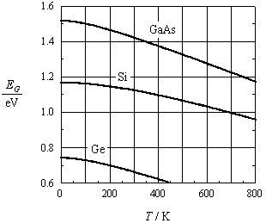
Intrinsic Carrier Concentrations vs. Temperature
Calculate and show position of Fermi level in doped Ge (10¹⁶ cm^{‑3} n-type impurities) at -15 ºC,

Slide 18
Equilibrium Carrier Concentrations
Considering n type doping only

Slide 19
Carrier Concentrations vs. Temperature: Extrinsic

Slide 20
Carrier Concentrations vs. Temperature: Extrinsic

Slide 21
Carrier Concentrations vs. Temperature
Lets do some mathematical shuffling

Slide 22
Equilibrium Carrier Concentrations: Freeze Out

Slide 23
Carrier Concentrations vs. Temperature: Extrinsic
: Freeze out to Extrinsic region transition

Slide 24
Carrier Concentrations vs. Temperature: Extrinsic
: Extrinsic to Intrinsic region transition

Slide 25
Equilibrium Carrier Concentrations: Extrinsic

